Slide 1
Geology Fieldwork
Anna Thompson
LA588 Final Project
May 6, 2019

Slide 2
Introduction
I wanted build a website that summarizes my fieldwork experience all in one place as a visual resume of sorts. Until now, I have never created something that addresses it all together, which this website does. Ideally, it can be incorporated into a personal website in the future.
Though much of it is simple, the goal was to make a complete website on a subject that can be presented in map form. Almost every page includes a Leaflet map with some markers. The home page map is most complex, as well as the QGIS map on the castleguard.html page. I have tried to be intentional about spacing, uniformity, and other formatting to achieve a professional looking webpage with relevant and interesting information.

Slide 3
Structure
Home page
Iowa State
Switzerland fieldwork
Banff fieldwork
Carleton College
Keck, Iceland thesis
Painted hills mapping project
New Zealand mapping projects
All subpages are accessible via the navigation bar and links in the popups on the homepage map.

Slide 4
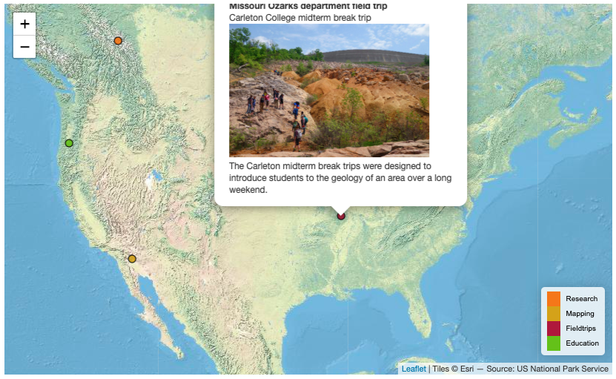
Home page
I have participated in fieldwork, fieldtrips, and mapping projects, which all have spatial components that can be represented on maps. The homepage features a large Leaflet map with markers that display where I have done such work, as well as some basic info in popups. Some points contain links to additional detail.
The data for each set of points (research, mapping, fieldtrips, and education) are saved in external JSON files:
fieldtrips.json
forefields.json
mapping.json
school.json

Slide 5
JSON example
L.geoJSON(mapping, {
pointToLayer: function(feature, latlng) {
var act = {
radius: 5,
fillColor: "#cc9900",
color: "#000",
weight: 1,
opacity: 1,
fillOpacity: 0.8
};
return L.circleMarker(latlng, act);
},
onEachFeature: function(feature, layer) {
//Box contents
photoURL = "photos/"+ feature.properties.photo+".jpg";
linkURL = feature.properties.url;
htmlText1 = "<strong>" + feature.properties.title + "</strong><br>" + feature.properties.caption + "<img src='" + photoURL + "'width='270'><br>" + feature.properties.description
htmlText2 = htmlText1+"<br>"+"<a href="+linkURL+">details</a>";
if(feature.properties.link=="no") htmlText =htmlText1;
if(feature.properties.link=="yes") htmlText =htmlText2;
layer.bindPopup(htmlText);
//hover
layer.bindTooltip(feature.properties.title);
}
}).addTo(map);
Each point group had java script code like this to plot marker points and popups. Complete code is accompanied by css and html. Purple text needed to be changed, in addition to adding or removing details.
Format marker
Define popup contents with or without link to details
Determine which popup text to use (link or no link)
Add popups on hover and click

Slide 6
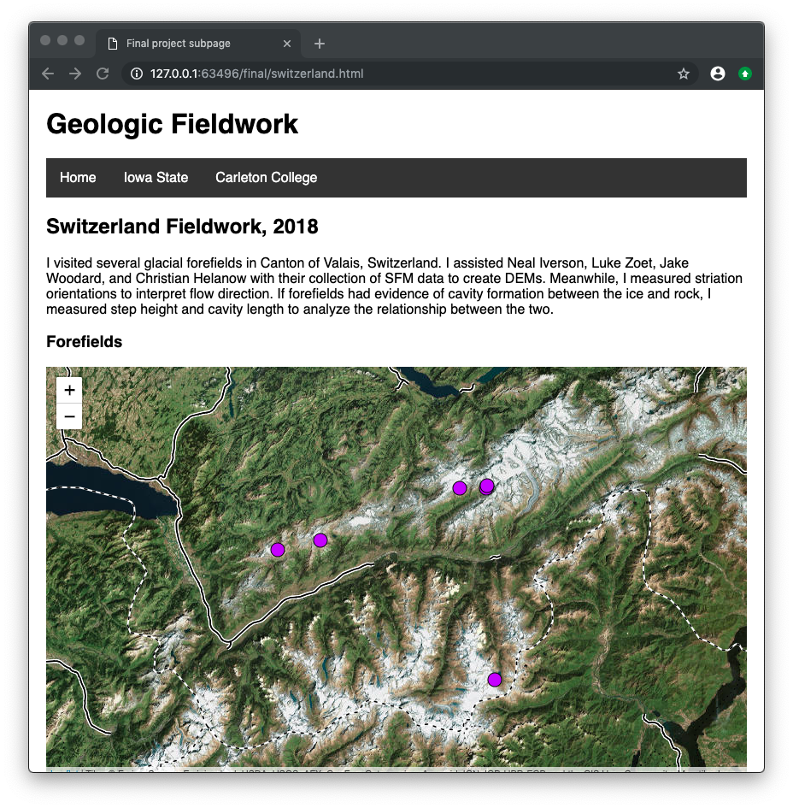
Switzerland fieldwork
Leaflet map
forefields.json
Link to external site
Photos

Slide 7
Basemaps example from switzerland.html
var Esri_WorldImagery = L.tileLayer('https://server.arcgisonline.com/ArcGIS/rest/services/World_Imagery/MapServer/tile/{z}/{y}/{x}', {
attribution: 'Tiles &copy; Esri &mdash; Source: Esri, i-cubed, USDA, USGS, AEX, GeoEye, Getmapping, Aerogrid, IGN, IGP, UPR-EGP, and the GIS User Community'
});
var Stamen_TonerLines = L.tileLayer('http://{s}.tile.stamen.com/toner-lines/{z}/{x}/{y}.png', {
attribution: 'Map tiles by <a href="http://stamen.com">Stamen Design</a>, <a href="http://creativecommons.org/licenses/by/3.0">CC BY 3.0</a> &mdash; Map data &copy; <a href="http://openstreetmap.org">OpenStreetMap</a> contributors, <a href="http://creativecommons.org/licenses/by-sa/2.0/">CC-BY-SA</a>',
subdomains: 'abcd',
minZoom: 0,
maxZoom: 20
});
Satellite imagery used in most maps for environmental context
Roads and political border imagery used in the Switzerland map because we were working near such things

Slide 8
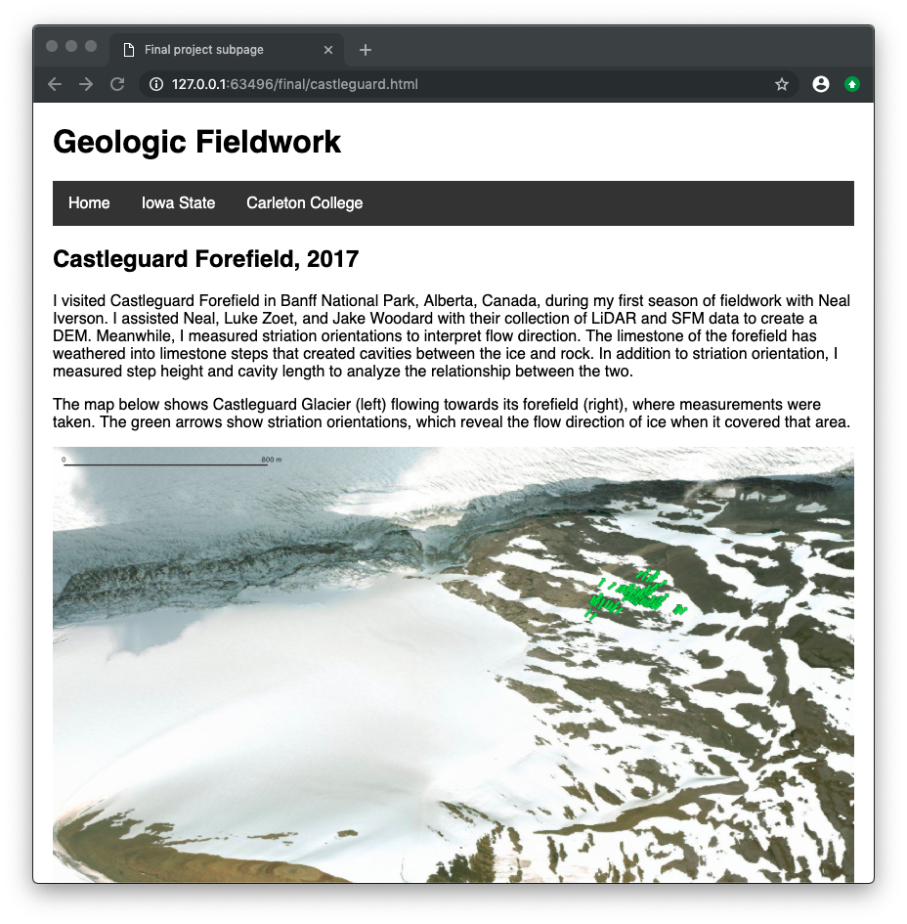
Banff fieldwork
QGIS map
Field data from .csv file
This map features rotated symbols by values from the attribute table. Unfortunately, this unique symbology could not be preserved when exported to a Leaflet map, so instead it is displayed here as a still.
Link to a pdf of a poster
Poster contents laid out and formatted for easy viewing within the site

Slide 9
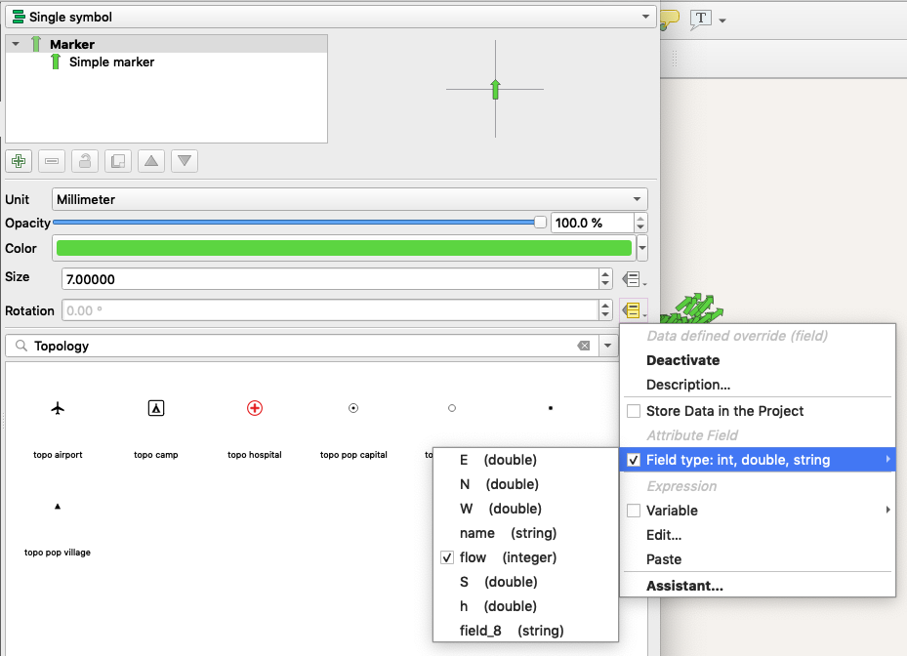
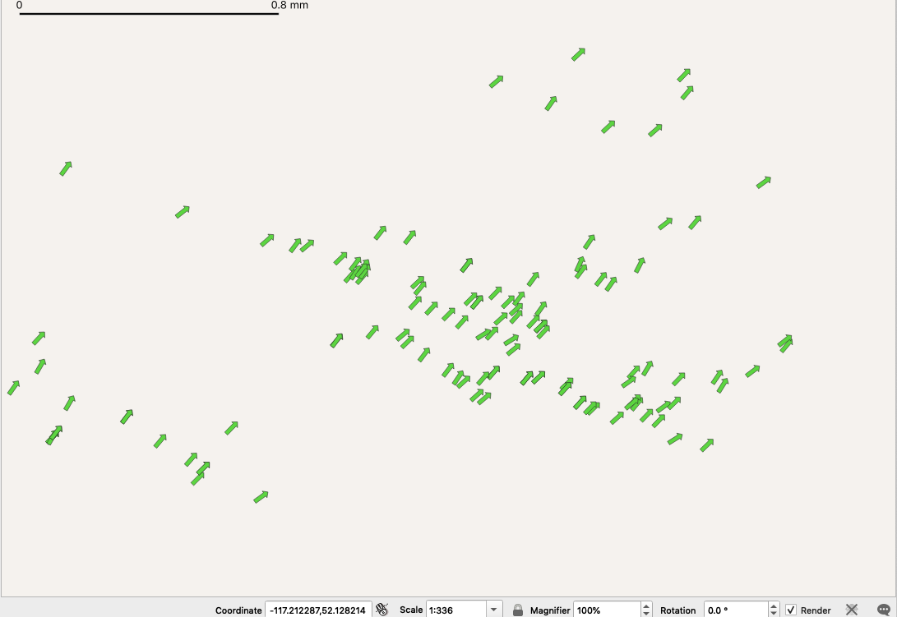
QGIS symbology

Slide 10
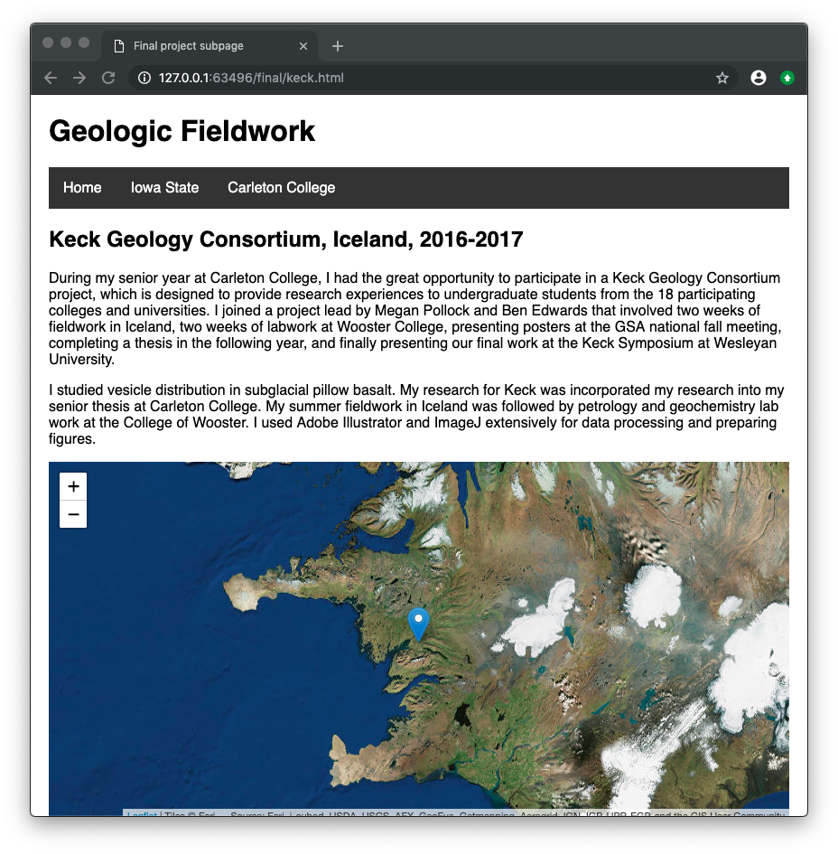
Keck, Iceland thesis
Leaflet map to indicate quarry location
Embedded pdf <embed src="keckdoc.pdf" width="100%" height="600px" />
Link to pdf <a href="keckdoc.pdf">Open pdf</a>
Photos

Slide 11
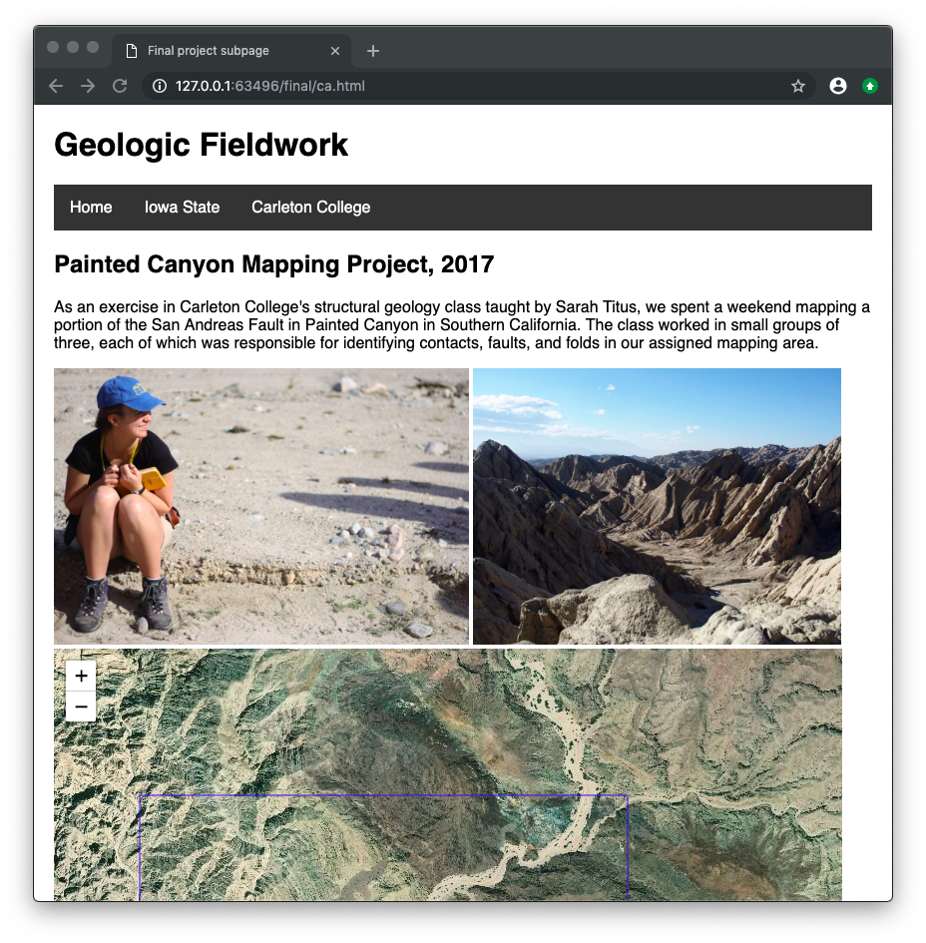
Painted Canyon Mapping Project
Photos
Leaflet map with a rectangle outlining our mapping area
I really wanted to include it, but unfortunately I couldn’t find the actual map we made!

Slide 12
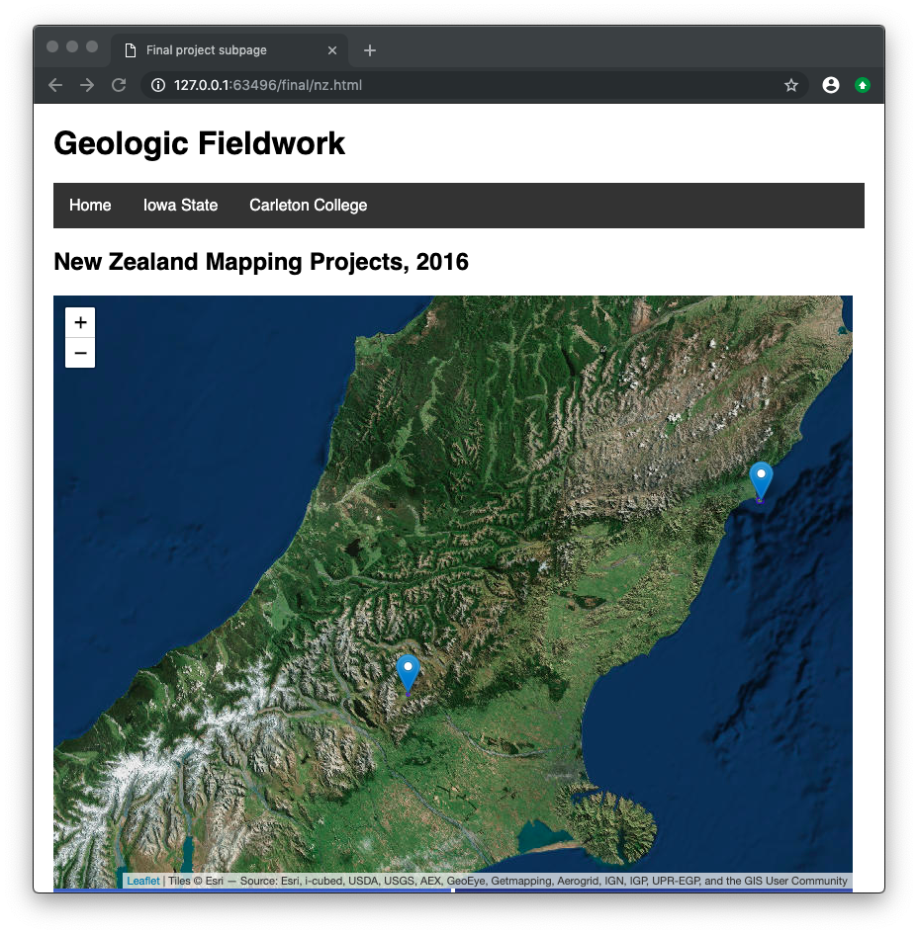
New Zealand Mapping Projects
Leaflet map
Photos
Again, I was hoping to include these maps but I can’t find them!
Because I couldn’t track down much info, this page shows two projects and is directed to by two points on the home map

Slide 13
Reflection
The final product includes some things I hadn’t originally thought of, as well as leaving out some original ideas because I couldn’t track down the data/maps I had in mind or otherwise decided that this new version was preferable. By the end of this project, I feel like I have tremendously improved on creating and managing a large number of detailed external json files, and finally understand the javascript code used to reference them and several different ways. It was nice to brush up on, and to finally try my hand at making a relatively large scale site with many subpages and internal links.
I am happy with the clean looking final product, and am open to suggested improvements, because I hope to continue to develop this site in the future.

